Slide 1
Standing out from the crowd, what the ambassadors badge did for me
28th May 10AM - 6PM
In Person event

Slide 2
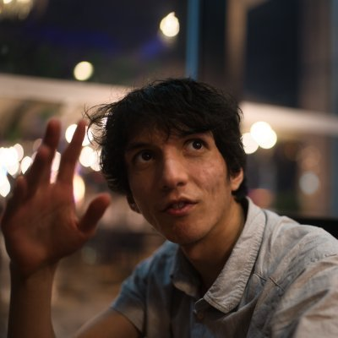
Microsoft Build: Student Developer Drop-In Day
28th May 10AM - 6PM
In Person Event
Salman Chishti
Microsoft Azure & Windows Insider MVP & MCT Regional Lead

Slide 3
The first ~ 20 years
Primary school
High School
University
Job

Slide 4

What if it were possible to work with companies before?

Slide 5
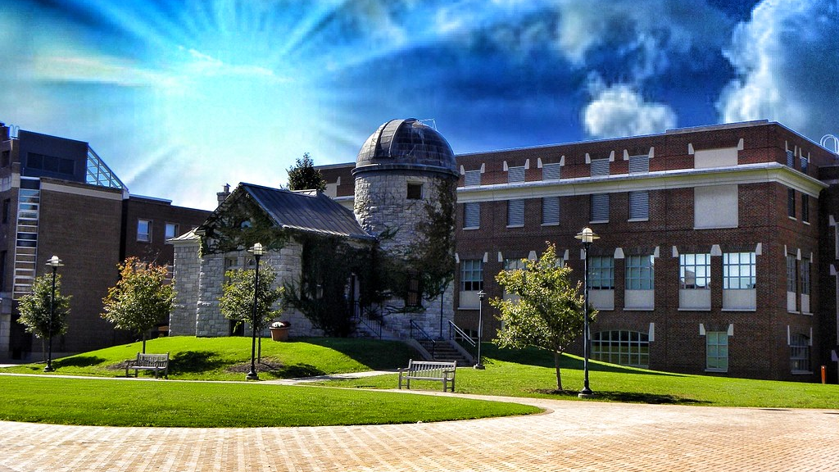
University is longgggg
This Photo by Unknown Author is licensed under CC BY-SA-NC

Slide 6
Find community projects
University societies
Work with your professors
Open source projects
Contribute to societies
Take up leadership positions

Slide 7
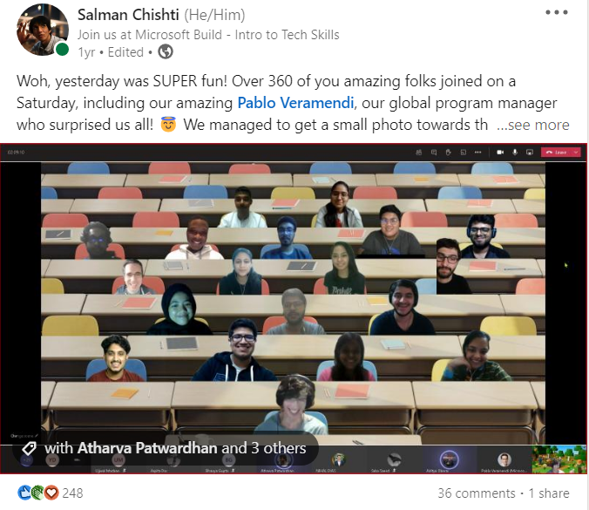
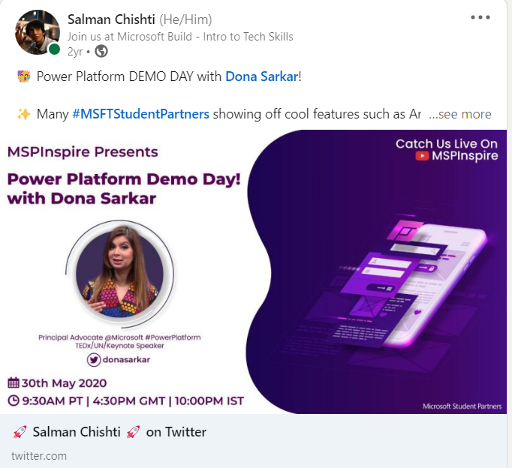
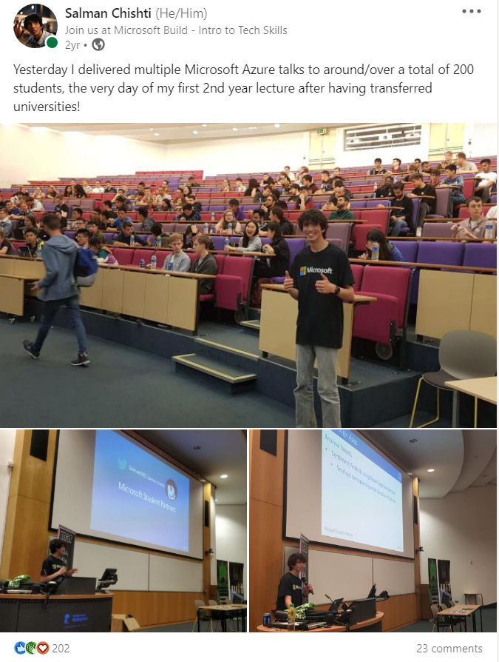
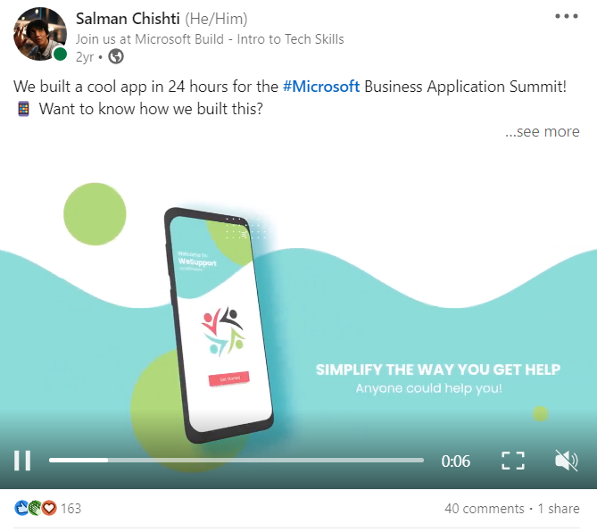
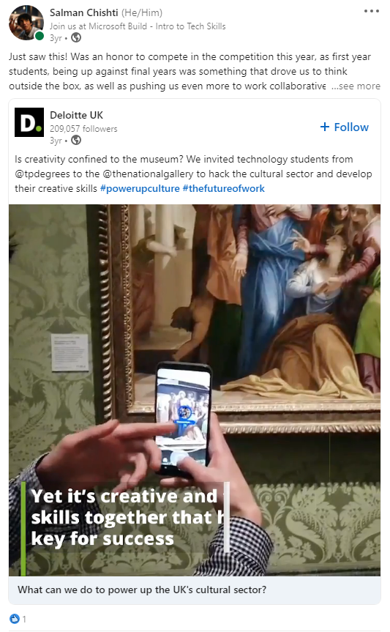
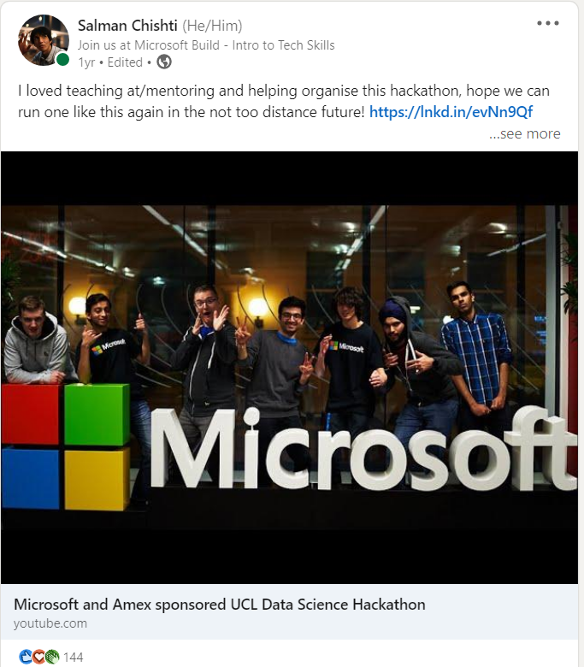
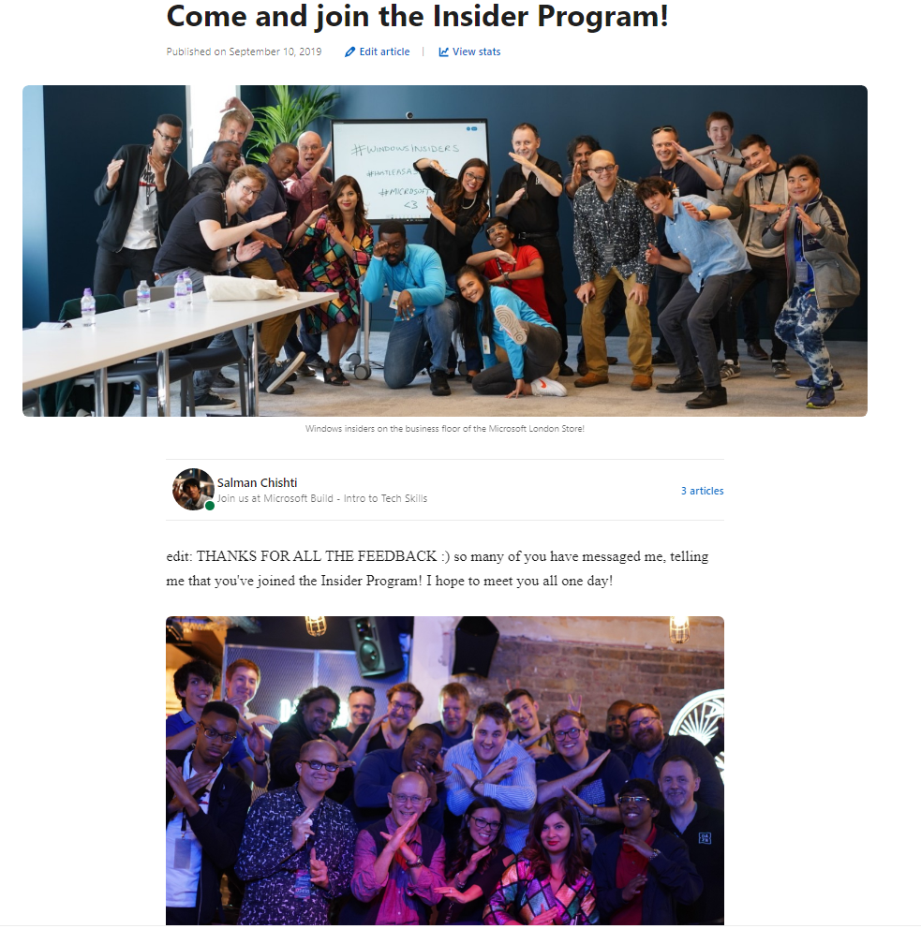
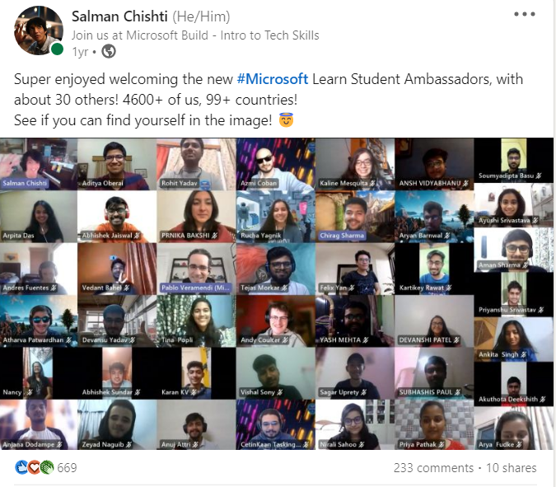
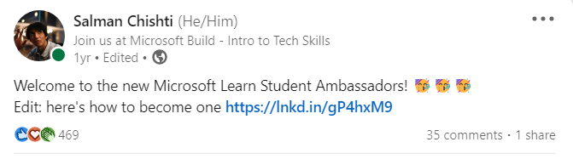
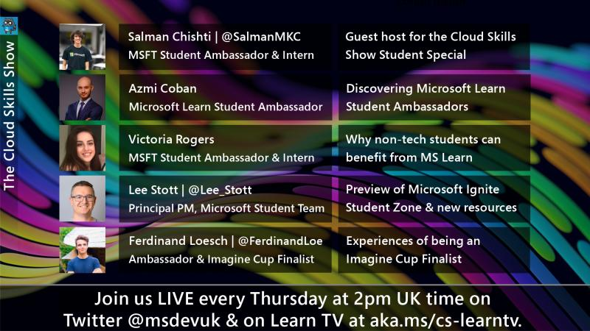
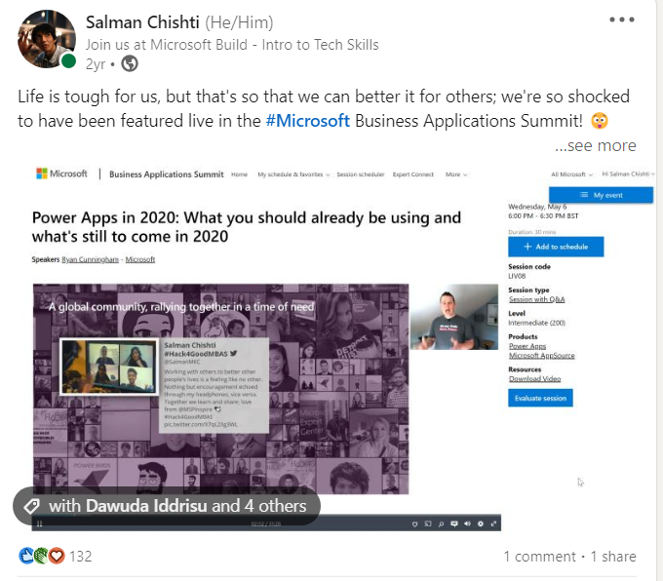

Slide 8
Through time
Primary school
High School
University + Your personal brand
Jobs?

Slide 9
Next steps
All the resources today!
Microsoft-Build-Student-Developer-Drop-in-day Resources
Windows Insider Program
Insider.windows.com Cloud Skills Challenge https://aka.ms/StudentDeveloperDayChallenge

Slide 10
My journey
Started coding because I found games limiting
School programming was limited
Content creation
University, president of Computer Science society in first year
Attended a bunch of Microsoft Events (including Windows Insider ones)
Tried to run Microsoft events
New university
Teaching coding through games
Cloud Solution Architect at Microsoft
Program Manager at Microsoft
Last exam May 2022
Microsoft Open Source
More open source
SWE, Data Analyst, HoloLens developer and worked for my university

Slide 11
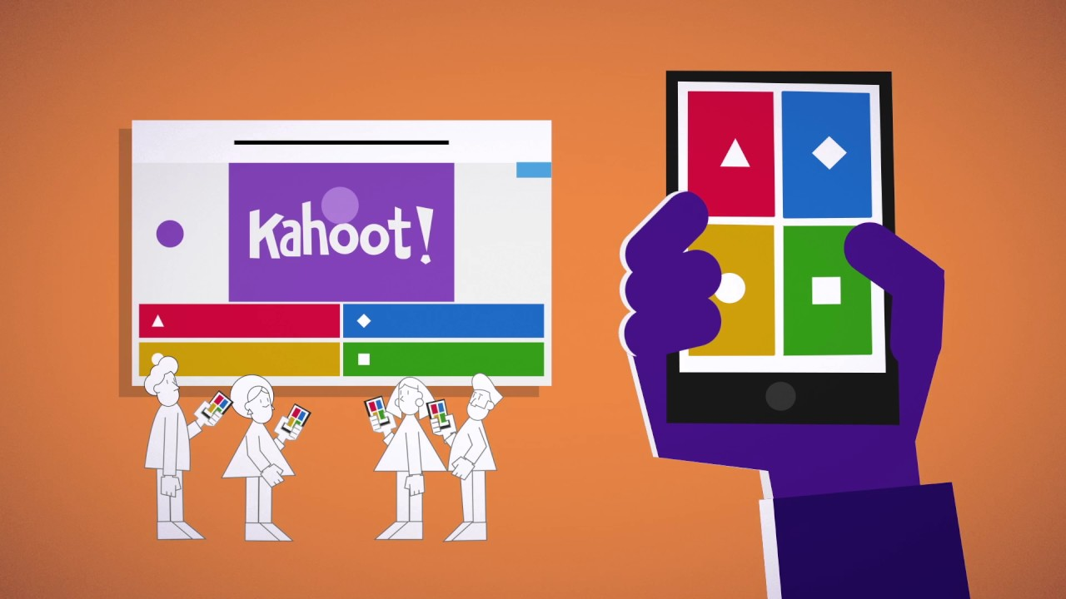
Quiz

Slide 12
Agenda Part 1
10.00 – 10.30
10.30 – 10.40
10.40 – 10.50
11.00 – 12.00
12.00 – 12.40
12.40 – 13.10
13.10 – 13.40
13.40 – 14.20
Welcome to the Student event - Speakers: Someleze Diko and Salman Chishti
Getting Started with Azure for Student - Speaker: Bethany Jepchumba
Getting Started with Microsoft Learn and free student certifications Speaker: Gemma Robson
AI Gaming Challenge Speaker: Stephen Graham AI Gaming
Lunch & Networking
Power Platform Low Code No Code Development Speaker: Bethany Jepchumba
Career Festive – What roles are in Microsoft for interns and Grads Speaker: Gianluca Sanfilippo, Ethan Jones, Rosen Georgiev and Host Aurele Mes Boaye
Introduction to programming hello world in 3 languages Speaker: Bruno Capuano

Slide 13
Agenda Part 2
14:20 – 14:30
Rock your Profile and Resume Builder with LinkedIn​ Speaker: Gianluca Sanfilippo​
14:30 – 14:40
Microsoft Certifications and the road to a tech job​ Speaker Rosen Georgiev​
14:40 – 14:50
Ambassadors showcase - Standing out from the crowd what the ambassadors badge did for me.​ Speaker Salman Chishti​
15:00 – 15:20
Ambassadors showcase - Ambassadors in the community – how to work with your dev community​ Speaker Salman Chishti and Susie Yang​
15:20 – 15:50
Gaming and Azure - Introduction to ID@Azure a new program to help you learn and make successful games using cloud services​ Speaker Bruno Capuano​
15:50 – 16:20
MVP Showcase - Home Automation with the Azure Percept​ Speaker Peter Gallagher​
16:30 – 17:00
Getting Started with Azure Static Web Apps to Host your Resume​ Speaker Bruno Capuano​
17:00 – 18:00
BUILD AI Gaming Challenge Final​ Speakers: Stephen Graham/ Bruno Capuano /Someleze Diko)​
18:00
Close and Celebration.​ Speakers: Someleze Diko Salman Chishti

